Slide 1
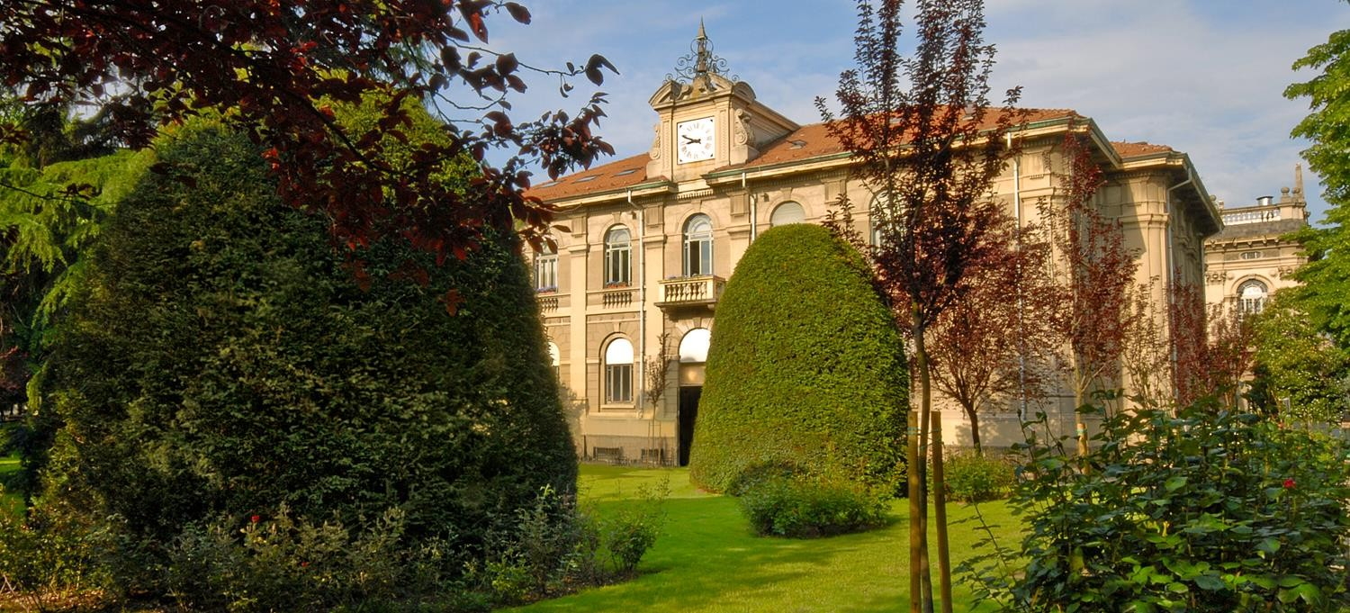

Image Analysis and Computer Vision Project (IACV)
EYE TRACKING AND GAZE ESTIMATION
AY 2019-2020
Pasquale Enrico Cortese (903147)
pasqualeenrico.cortese@mail.polimi.it

Slide 2



Problem formulation and solution approach
Eye tracking is the measurement of eye movement/activity and gaze (point of regard) tracking is the analysis of eye tracking data with respect to the head/visual scene.
The goal of this project was to show how gaze tracking can provide assistance in the act of reading, detecting the instant when the reader has reached the End-of-Page in an electronic book in order to automatically turn the page.
The project was executed using the
Matlab enviroment
Pasquale Enrico Cortese Eye tracking and gaze estimation

Slide 3
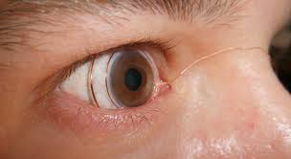
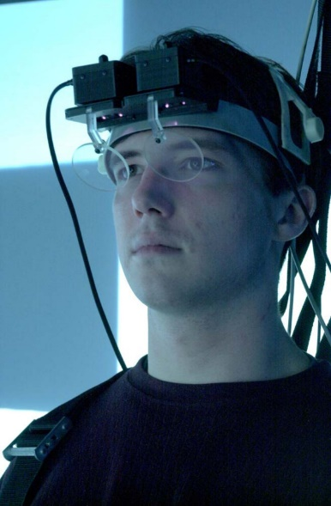
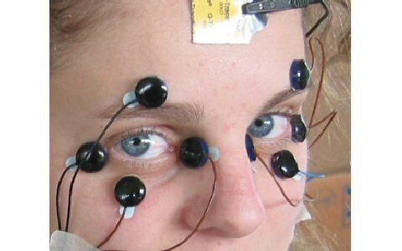
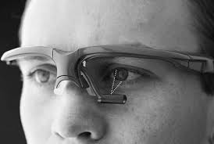
State of the art
Sceleral Search Coils
Electro-Oculography
Video Oculography
Infrared Oculography
Pasquale Enrico Cortese Eye tracking and gaze estimation

Slide 4
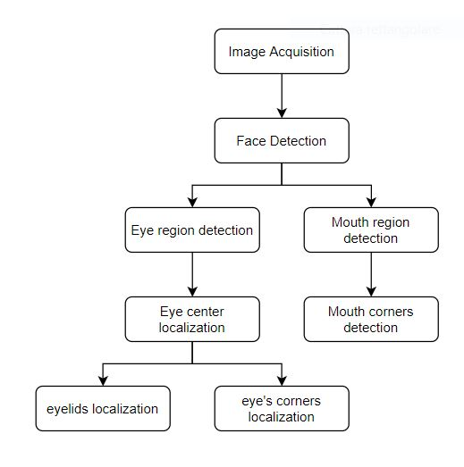
Solution approach and code flowchart
The main while loop is divided into three principal phases:
Detection;
Tracking;
Feature collecting and prediction;

Slide 5
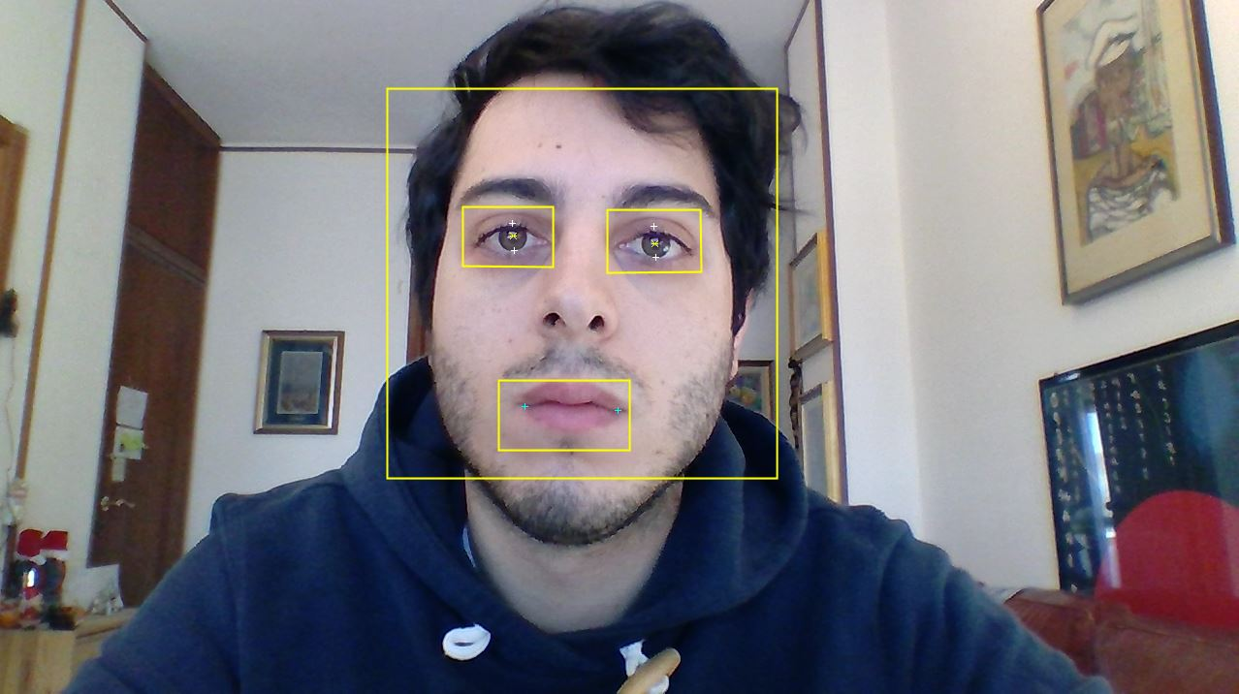
Solution approach - Detection
Once the face box is found, this is exploited to create before regions of interest where to detect, with the same routine above, the left and the right eye, and from the respective regions of interest the eye centers are localized, and after a region of interest where to find the mouth and thus the mouth’s corners; eventually, from the eye centers the eyelids and the eye corners are localized.

Slide 6
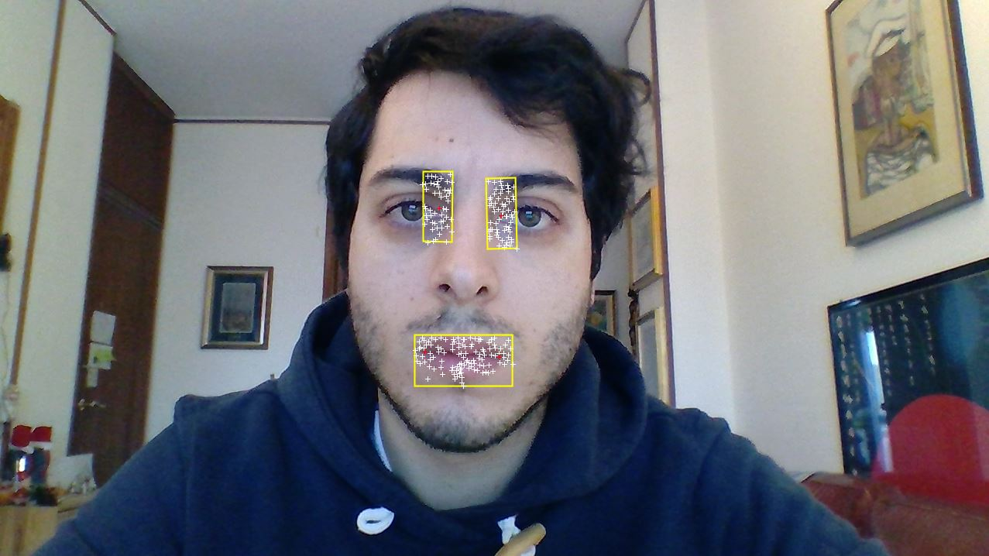
Solution approach - Tracking
Once the desired points are detected, the two regions of interest for each eye plus the one for the mouth are used to initialize the Kanade-Lucas-Tomasi (KLT) tracking algorithm, using the detection features by Shi-Tomasi; thus five trackers are used. Each tracker is initialized using the entire frame image and as region of interest the ones previously found. As the point tracker algorithm progresses over time, points can be lost due to lighting variation, out of plane rotation, or articulated motion. To solve this problem, the tracker is re-initialized when the visible points are less then the fixed threshold. From the tracked region of interest the desired points of interest are localized

Slide 7
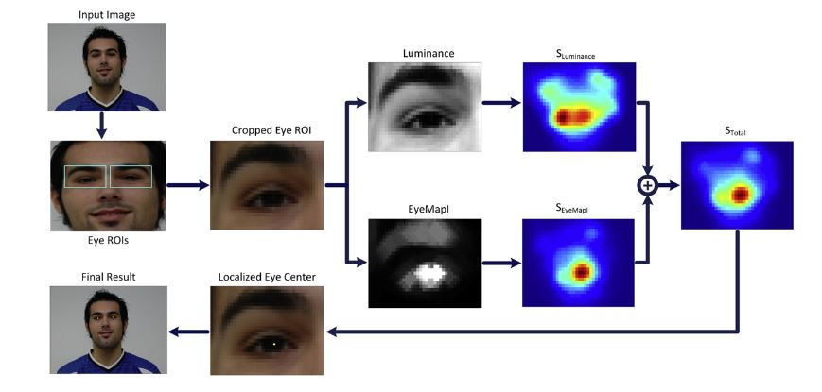
Localization – Eye centers
Given the region of interest from the Viola-Jones detection of the eyes, the localization of the eye centers is performed in a few steps. The image cropped, correspondent to the region of interest, is converted from RGB to YCbCr color space.
Color information and Fast-radial symmetry transform are used to localize the eye centers

Slide 8
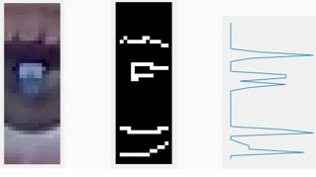
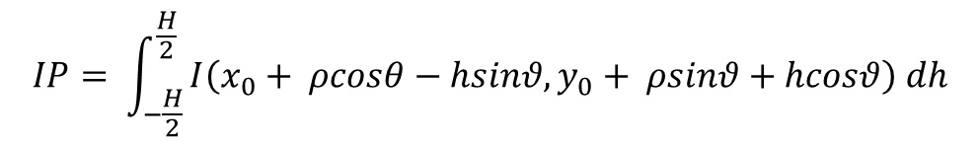
Localization – Eyelids
The x-position of the eyelids is regarded the same as those of the corresponding eye centers. Starting from the localized eye center we define a rectangular Region of Interest (ROI) in which the eyelids are searched, using heuristic parameters. Edges are searched in the cropped image using canny filter and the integral projection (generalized to detect projections on different angles) is used to look for the eyelids.
$$IP= \int_{−\frac{H}{2}}^{\frac{H}{2}}{I\left(x_{0}+ ρcosθ−hsinθ, y_{0}+ ρsinθ+hcosθ\right) dh}$$

Slide 9
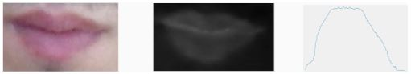
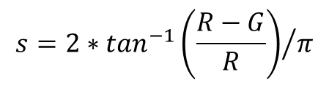
Localization – Mouth’s corners
The region of interest in the face box is set through heuristic parameters. First the Roi is cropped and the chromatism values s is obtained; then the integral projection is used to obtain first in which points s exceeds a fixed threshold and those two points are used to obtain the x coordinates, secondly integral projection is used again in the x-coordinates to obtain the relatives y-coordinates.
$$s=2∗\tan^{−1}{\left(\frac{R−G}{R}\right)}/π$$

Slide 10
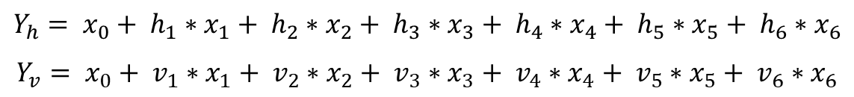
Gaze estimation – the model
$$Y_{h}= x_{0}+ {h_{1}∗x}_{1}+ {h_{2}∗x}_{2}+ {h_{3}∗x}_{3}+ {h_{4}∗x}_{4}+ {h_{5}∗x}_{5}+ {h_{6}∗x}_{6}$$
$$Y_{v}= x_{0}+ {v_{1}∗x}_{1}+ {v_{2}∗x}_{2}+ {v_{3}∗x}_{3}+ {v_{4}∗x}_{4}+ {v_{5}∗x}_{5}+ {v_{6}∗x}_{6}$$
A linear regression approach is used. Two mapping functions, one for each direction (along x and y axes), are learned. Given the assumption of independence of gaze estimation in the two axes, two separate feature vectors are formed as horizontal and vertical distances between moving and anchor points.

Slide 11
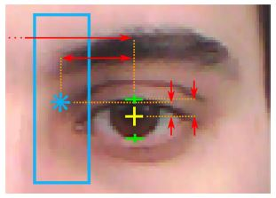
Gaze estimation – the collected features
- Horizontal features:
- horizontal distance between left eye center and left eye corner;
- horizontal distance between right eye center and right eye corner;
- horizontal distance between right eye center and eye corner;
- horizontal distance between left eye center and left mouth corner;
- horizontal distance between right eye center and right mouth corner;
- horizontal distance between left eye center and right mouth corner;
- Vertical features:
- vertical distance between left eye center and left eye corner;
- vertical distance between right eye center and right eye corner;
- vertical distance between left anchor point and left eyelid;
- vertical distance between right anchor point and right eyelid;
- vertical distance between left mouth corner and left eye center;
- vertical distance between right mouth corner and right eye center;

Slide 12

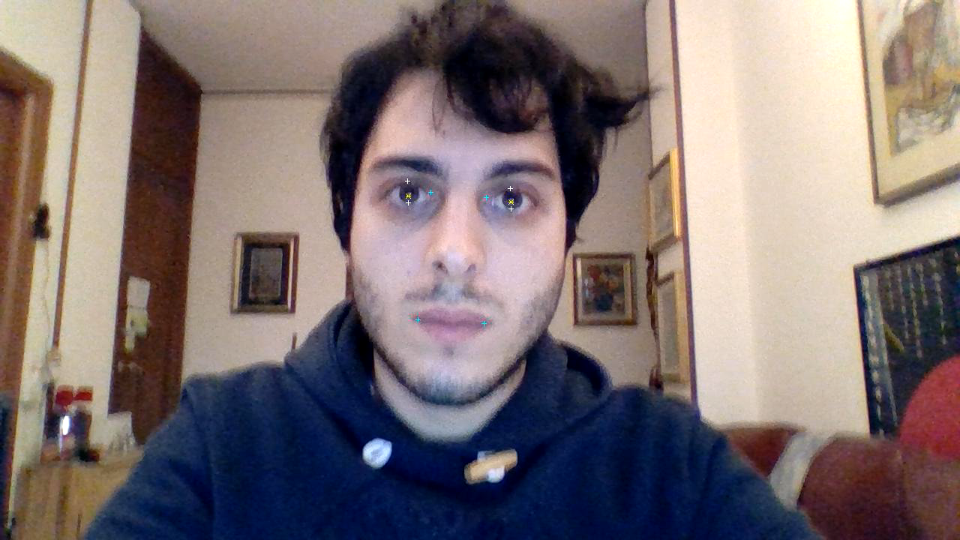
Calibration procedure
In the calibration phase some points, randomly chosen, are showed to the user, lighting them one by one and registering the feature vectors in that known positions. After calibration I have correspondences between known points on the screen and the relative features, allowing me to train the linear regression model.

Slide 13
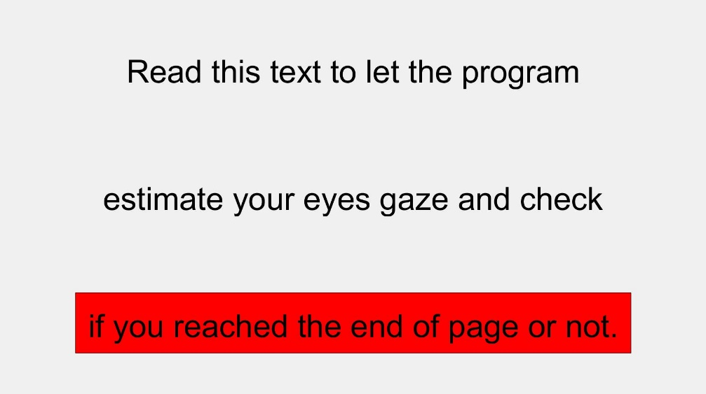
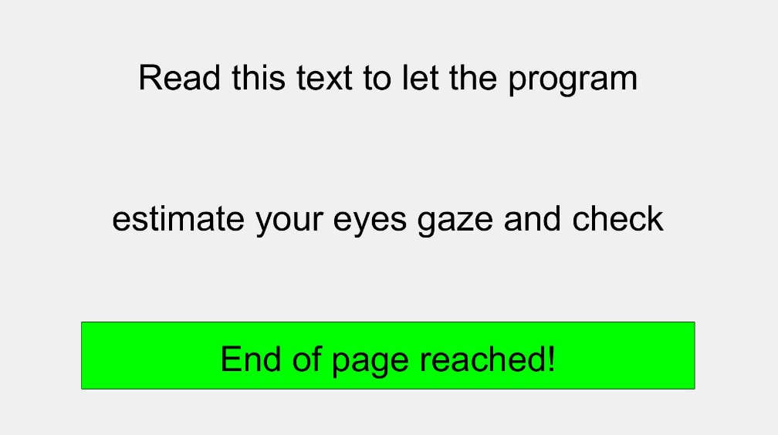
Testing procedure
To approximate a real situation where this project can be used, a text is inserted in a figure: when the user arrives to the end of page the desired action for the specific application can be triggered, which in the test script was set to signal the end of page was reached.

Slide 14
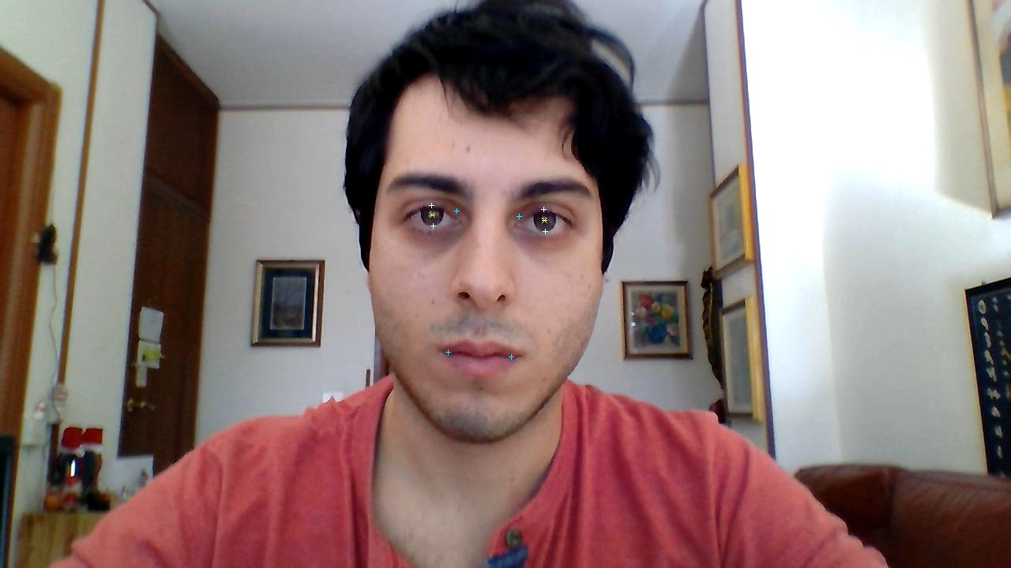
Testing procedure
It’s possible to observe that the movement of the eyes correspond to the reading of a three line text and that it ends when the last line after the last line has been red.

Slide 15
Discussion
The solution used to approach the formulated problem presents both weak and strong points: the use of color information to locate the eye center is far more reliable than geometric interpolation methods, and it is proven that this method doesn’t require high resolution images, a fact that can be exploited to achieve a faster execution of the program. Also, the color information is immediately robust to change of the pose, differently to geometric interpolation. On the other hand, uneven illumination, shadows or reflections, like in the case of the user wearing eyeglasses, may trick the program.
The fixed goal was reached: to record the gaze point on the screen and to trigger an action in the program when the end of the page was reached.
Pasquale Enrico Cortese Eye tracking and gaze estimation

Slide 16
Future work: improvements
List of possible improvements:
Make the localization algorithms robuts to light characteristics in the photo;
implementation of a policy about noise reducing and continuity check;
Detection of face not aligned with the camera
Pasquale Enrico Cortese Eye tracking and gaze estimation

Slide 17
Thank you for listening

